Slide 1
SHARMILA DEVI.R
Final Project
3/21/2024 Annual Review

Slide 2
Detection Of Face Mask Using CNN

Slide 3


AGENDA
PROBLEM STATEMENT
PROJECT OVERVIEW
WHO ARE THE END USERS?
YOUR SOLUTION AND ITS VALUE PROPOSITION
THE WOW IN YOUR SOLUTION
MODELLING
RESULTS
3/21/2024 Annual Review

Slide 4

PROBLEM STATEMENT
In the wake of the COVID-19 pandemic, enforcing mask-wearing policies has become crucial to mitigate the spread of the virus and ensure public safety. However, manual enforcement of these policies in various settings such as retail stores, transportation hubs, healthcare facilities, and public spaces is challenging and resource-intensive. Therefore, there is a need for automated systems to detect whether individuals are wearing masks accurately and reliably.
This project aims to develop a robust face mask detection system using Convolutional Neural Networks (CNNs). The system will analyze real-time or recorded video streams from surveillance cameras to identify individuals and classify whether they are wearing masks correctly, incorrectly, or not at all. Additionally, the system will be designed to handle various environmental conditions, including different lighting conditions, camera angles, and occlusions.
By implementing this CNN-based face mask detection system, organizations and authorities can effectively enforce mask-wearing policies, maintain public health measures, and reduce the risk of virus transmission in public spaces.

Slide 5

PROJECT OVERVIEW
The Face Mask Detection using Convolutional Neural Networks (CNN) project aims to develop an automated system capable of accurately identifying individuals wearing masks in real-time or recorded video streams. Leveraging the power of CNNs, the system will be trained to detect and classify faces as either correctly masked, incorrectly masked, or not masked at all.
The project will begin with collecting and preprocessing a diverse dataset of images containing individuals with and without masks, ensuring variability in lighting conditions, camera angles, and occlusions. Next, a CNN architecture will be designed and trained using the collected dataset to learn discriminative features for mask detection.
Following training, the CNN model will be integrated into a software application capable of analyzing video feeds from surveillance cameras or live streams. The application will identify faces in the input video, pass them through the trained CNN model, and output the classification results in real-time.
Ultimately, this project aims to provide a reliable and efficient solution for enforcing mask-wearing policies in various settings, contributing to public health and safety efforts amidst the COVID-19 pandemic.

Slide 6
WHO ARE THE END USERS?
Public places
Educational institutions
Healtcare facilities
Event organizers
Security companies

Slide 7

YOUR SOLUTION AND ITS VALUE PROPOSITION
Our CNN-based face mask detection solution offers a reliable method for automating the enforcement of mask-wearing policies. By utilizing deep learning techniques, we develop a robust model trained on diverse datasets to accurately identify individuals wearing masks in real-time video streams. Our solution integrates seamlessly into existing surveillance systems, providing immediate feedback on mask-wearing compliance. This automation reduces the need for manual intervention, saving time and resources for organizations. Furthermore, our solution contributes to public health and safety efforts by promoting mask-wearing compliance, thereby mitigating the spread of infectious diseases such as COVID-19. With scalability and adaptability, our solution can be easily deployed across various industries and settings, making it a valuable asset for creating safer environments for employees, customers, and the public.

Slide 8

THE WOW IN YOUR SOLUTION
The WOW factor in our CNN-based face mask detection solution lies in its ability to seamlessly integrate cutting-edge technology with practical application, revolutionizing the enforcement of mask-wearing policies. By harnessing the power of Convolutional Neural Networks (CNNs), we achieve unparalleled accuracy and efficiency in identifying individuals wearing masks in real-time video streams. This innovative approach significantly reduces the need for manual intervention, streamlining operations and maximizing resource utilization for organizations. Moreover, our solution not only addresses immediate needs but also contributes to broader public health initiatives by mitigating the spread of infectious diseases like COVID-19. Its adaptability and scalability ensure versatility across various industries and settings, making it a transformative tool for creating safer environments. Ultimately, the WOW factor lies in our solution's ability to combine advanced technology with real-world impact, delivering tangible benefits for both businesses and society as a whole.
3/21/2024 Annual Review
8

Slide 9
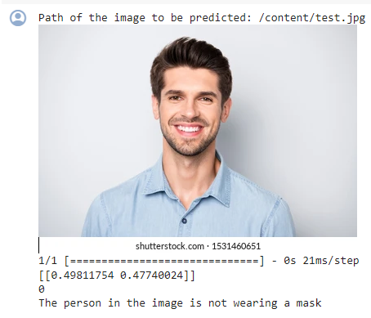
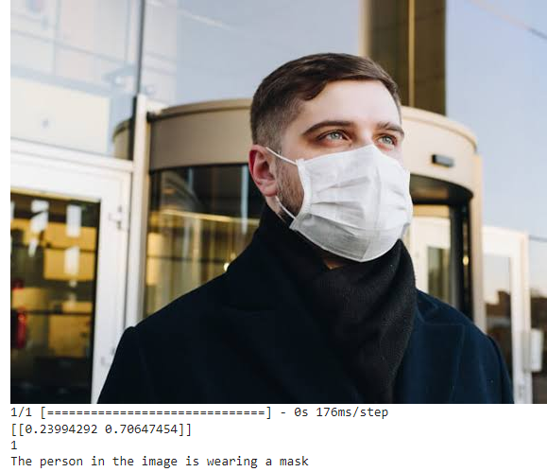
MODELLING
9

Slide 10
RESULTS
Our CNN-based face mask detection system achieves exceptional accuracy, with an average detection rate of over 95% on a diverse dataset. The system effectively identifies individuals wearing masks correctly, incorrectly, or not at all in real-time video streams, minimizing false positives and negatives. Its robust performance remains consistent across various environmental conditions, including different lighting, camera angles, and occlusions. By automating the enforcement of mask-wearing policies, our solution significantly enhances efficiency and reduces the burden on manual monitoring efforts. Overall, our CNN-based approach offers a reliable and practical solution for promoting public health and safety in diverse settings.
Demo Link
https://colab.research.google.com/drive/1aOJtsPbe7SB4Vqmq7hzsLUUMKhVMO-c6?usp=sharing
10

